Slide 1
Year 7
Social media – friend or foe!
Notes:
Will need to explain Social Media or have a discussion around this. What is it? What does it involve? Who does it involve?
Can the children recognise the app logo before sharing what it is?

Slide 2
Look at the following images
Do you know how old you need to be to use it according to official guidelines?
Notes:
Will need to explain Social Media or have a discussion around this. What is it? What does it involve? Who does it involve?
Can the children recognise the app logo before sharing what it is?

Slide 3


Notes:
Snapchat (Image and photo sharing/video chat)
Snapchat’s official guidelines suggest you should only be using this app if you are 13 years old or more.

Slide 4

Notes:
Facebook (image and photo sharing/video chat/ content sharing)
Facebook’s official guidelines suggest you should only be using this app if you are 13 years old or more.

Slide 5

Notes:
Twitter (Messaging and content sharing)
Twitter’s official guidelines suggest you should only be using this app if you are 13 years old or more.

Slide 6

Notes:
Instagram (image and photo sharing/ Content sharing and Messaging)
Snapchat’s official guidelines suggest you should only be using this app if you are 13 years old or more.

Slide 7

Notes:
Facebook Messenger (Messaging/image and photo sharing/video chat/voice calls)
Facebook Messenger’s official guidelines suggest you should only be using this app if you are 13 years old or more.

Slide 8

Notes:
Minecraft (Gaming/messaging)
Minecrafts’s official guidelines suggest you should only be using this app if you are 13 years old or more.

Slide 9

Notes:
Clah of Clans (Gaming and Messaging)
Snapchat’s official guidelines suggest you should only be using this app if you are 13 years old or more.

Slide 10

Notes:
YouTube (Content Sharing/video chat/gaming/messaging)
YouTube’s official guidelines suggest you should only be using this app if you are 13 years old or more.

Slide 11


Notes:
WhatsApp (Messaging/video chat/image and photo sharing)
WhatsApp’s official guidelines suggest you should only be using this app if you are 16 years old or more.

Slide 12
These official guidelines are there to protect YOU!
Notes:
Will need to explain Social Media or have a discussion around this. What is it? What does it involve? Who does it involve?
Can the children recognise the app logo before sharing what it is?

Slide 13
Whatsapp and Year 7
What do children and young people like about WhatsApp?
Group chats can be used plan events or talk about common interests
You can send images, messages or videos to your friends
You only need a phone number to be able to join
What do children and young people dislike about WhatsApp?
Group chats can be used to bully people and offend with poor language and content choices.
It can be addictive
You can't report
Notes:
Will need to explain Social Media or have a discussion around this. What is it? What does it involve? Who does it involve?
Can the children recognise the app logo before sharing what it is?

Slide 14
The following scenario is based on made up events………..
😱😱😱😱
Notes:
Will need to explain Social Media or have a discussion around this. What is it? What does it involve? Who does it involve?
Can the children recognise the app logo before sharing what it is?

Slide 15
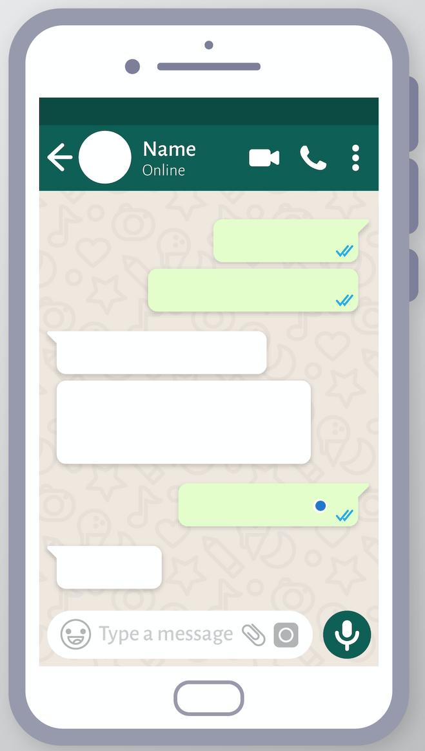

Miss Achard
Miss Achard
Mr Solly
I saw you fall over today
😂😂😂
I saw you fall over today
😂😂😂
😢😢😢😢😢
I saw you fall over today!!!
😂😂😂
I’m glad you find it so funny!!! It really hurt- you’re mean 😡 😡 😡
😢😢😢😢😢
Mr & Mrs Roberts ©
@mrmrsroberts_ (Instagram)

Slide 16
Whatsapp and Year 7
Miss Achard left the group!
Miss Achard thinks that Mr Solly is really mean for laughing at her
Miss Achard is never going to speak to Mr Solly again!
Mrs Lowe feels sorry for Miss Achard
Mr Solly is annoyed that Miss Achard is angry and left the group!
Mr Solly only put the laughing emoji because he saw Miss Achard laughing about falling over earlier
Mr Solly put the crying emoji as a form of sympathy he wasn’t trying to be mean
Mrs Lowe feels sorry for Mr Solly too
Mrs Lowe gets messages from Mr Solly and Miss Achard – she doesn’t want to fall out with anybody
Mrs Lowe leaves the group – Mr Solly is angry again
Notes:
Will need to explain Social Media or have a discussion around this. What is it? What does it involve? Who does it involve?
Can the children recognise the app logo before sharing what it is?

Slide 17
Whatsapp and Year 7
How quickly did that turn into something unpleasant?
Miss Achard misunderstood what Mr Solly was meaning with the laughing emoji and she left the group to make a point
Mr Solly didn’t mean it at all and actually felt sorry for Miss Achard but now he’s annoyed at her for overreacting!
Poor Mrs Lowe got involved because she is friends with both of them but didn’t do anything wrong.
They all feel like they have been treated badly and Miss Achard might even get the sack!!!!!!
Notes:
Will need to explain Social Media or have a discussion around this. What is it? What does it involve? Who does it involve?
Can the children recognise the app logo before sharing what it is?

Slide 18
It is very easy to write things on Whatsapp without thinking
Things to consider
It is very easy to write things on Whatsapp that you wouldn’t feel brave enough saying to somebody’s face
It is very easy to misinterpret words or intentions on Whatsapp
It is very easy to feel left out or targeted on large group chats on Whatsapp
It is very difficult to walk away from Whatsapp (leave the group) without offending somebody
Notes:
Will need to explain Social Media or have a discussion around this. What is it? What does it involve? Who does it involve?
Can the children recognise the app logo before sharing what it is?

Slide 19
Think about our UCC school values when you use apps like Whatsapp:
A proportion of Year 7 are already becoming upset on Group chats out of school.
Kindness: Are you being kind to everyone who is or has been in the group?
How would you feel if what you wrote was written about you? Would you be happy about it? If not then don’t write it.
Notes:
Will need to explain Social Media or have a discussion around this. What is it? What does it involve? Who does it involve?
Can the children recognise the app logo before sharing what it is?

Slide 20
Think about our UCC school values when you use apps like Whatsapp:
Respect: Are you being respectful?
Is the wording that you are using offensive? If you wouldn’t use the word in a conversation with your parents it is not an appropriate word with your peers.
Respect other peoples right to not see upsetting images or videos in a group chat that they would not want to see
Notes:
Will need to explain Social Media or have a discussion around this. What is it? What does it involve? Who does it involve?
Can the children recognise the app logo before sharing what it is?

Slide 21
Think about our UCC school values when you use apps like Whatsapp:
Honesty:
Be honest – would you say what you write to their face? If not don’t say it online!
Notes:
Will need to explain Social Media or have a discussion around this. What is it? What does it involve? Who does it involve?
Can the children recognise the app logo before sharing what it is?

Slide 22
We cannot monitor what goes on out of school but we still expect you to all be nice people with your peers
If you have been unkind to somebody on a group chat, it is fair to say that someone will probably be unkind to you back!
You can turn off notifications or delete the group – you do not need to part of something unless it is fun for all of you!
Consider making a smaller private group with just close friends
If you are using apps like Whatsapp you all need to responsible for your words and actions towards others
Notes:
Will need to explain Social Media or have a discussion around this. What is it? What does it involve? Who does it involve?
Can the children recognise the app logo before sharing what it is?

