Slide 1


Rutland Sports Leadership Academy

Slide 2
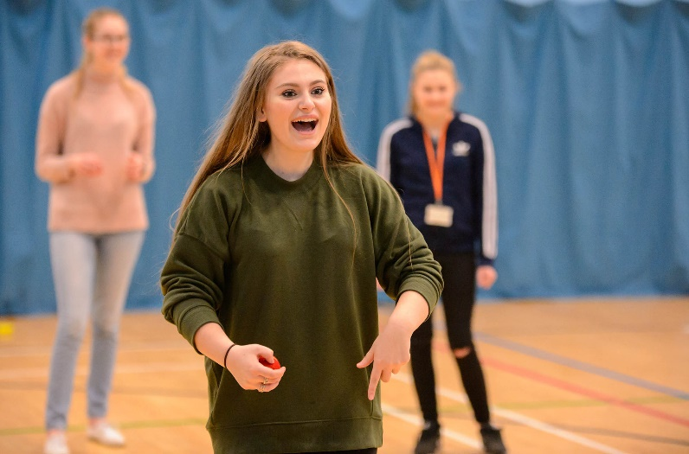
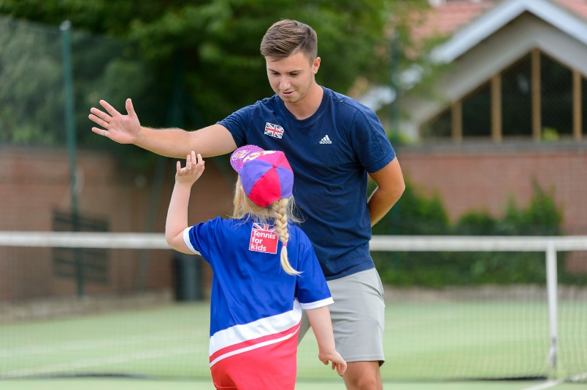
Who are we?
We are a team of young leaders who work together to provide opportunities for sport and physical activity within our schools and wider community.

Slide 3
Our aim is to…
Increase levels of participation in physical activity and sport
Provide more opportunity for young people to compete in sport
Develop young people’s sport leadership skills and experiences

Slide 4
The Leadership Academy can offer you…
Regular leadership training
The support to be involved in volunteering and leadership opportunities
Opportunities to work within a team that makes a difference in your school and community
Experience in leading and teaching others in a PE, sport and coaching environment
The scope to develop skills for personal growth
Access to National Governing Body Awards coaching and Leadership Awards

Slide 5
What will I be doing?
Promoting physical activity and sport in school
Delivering warm-up and cool-down session in PE
Helping to run a Extra-Curricular club
Volunteering as a sports leader in school and the community
Organising a sports competition

Slide 6
What are we after?
Students with the ability to…
- Communicate effectively
- Be a role model
- Influence and inspire young people
… In order to become top quality leaders that represent Casterton at our Leadership Academy

Slide 7
Thank you
If you would like to be involved or for further information please contact:
Mr Lewin at Active Rutland
e: RLewin@rutland.gov.uk

