Slide 1

Bronze eDofE Launch

Slide 2
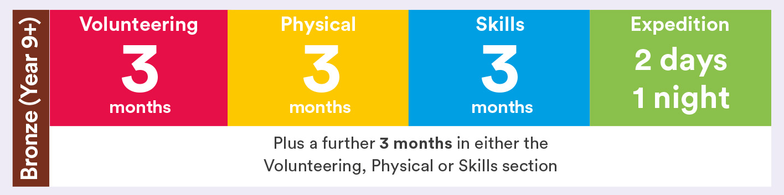
How long will it take me?
Activities for each DofE section take a minimum of one hour per week over a set period of time, so they can be fitted in around your studies and life outside school.
You’ll need to participate regularly and show that you’re committed to your DofE during this time.
25%
25%
25%
25%

Slide 3
General Requirements
You can continue with activities you are already doing
All sections do not need to be done at the same time but can be
You will need to set a goal for each activity
You need to identify an assessor for each section before you begin
You need an assessor for each section (this cannot be family) you can do activities from home but you must have an assessor possibly someone in college or the community. You would agree with them what evidence they expect to see and this person will write your report at the end.

Slide 4
Section Requirements
Volunteering – Must be a charity or community interest activity. You cannot volunteer for a commercial organisation
Physical - Check the activity is in the correct section on the programme ideas sheet.
Skill - Check the activity is in the correct section on the programme ideas sheet.
Activities must be done outside of curriculum time. There are lots of extra curricular activities at school you could use.

Slide 5

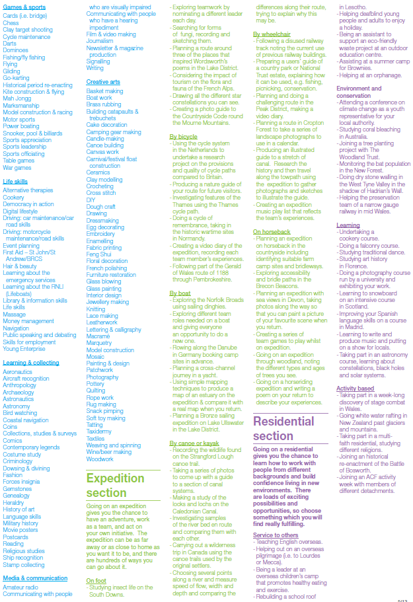
Programme Idea
eDofE
Notes:
Open discussion – randomly ask participants what sections they may have already chosen for one of their sections and discuss whether this meets the criteria or not. Leaders are looking for examples of good practice and weed out incorrect activities.
Maybe use the ball from the programmes pack and ask individuals to suggest a good volunteering activity, discuss their answer and ask to throw the ball to another participant and proceed to ask about suggestions for the other sections.
Once complete, Leaders may find young people are keen to confirm their chosen activities – print off a number of the programme ideas/display the laminated cards from the Programmes Pack for your participants to have a look through to identify suitable activities.

Slide 6

DofE with a Difference
You can continue to do your DofE from home.
We recommend you use this time to focus on Volunteering, Physical and Skill so that all you need to do is the Expedition Section.
Speak to the DofE Manager if you are unsure!
https://www.dofe.org/dofewithadifferencel

Slide 7
Volunteering Ideas
You can be a social media volunteer for St John Ambulance
You can fundraise to raise money for the Royal medical Benevolent Fund through Medic Mentor
You can take part in a John Muir Award and help to conserve nature from home
Volunteer for Kissing It Better and remote support elderly people who are in isolation
Take part in a digital personal safety campaign with Resolve It
St John Ambulance – 12 week fundraising plan
Try some ideas from Leonard Cheshire’s guide to 12-week volunteering from home
Create a fundraising plan for the British Heart Foundation
Become an Energy Envoy with the National Energy Foundation

Slide 8
More Volunteering Ideas
Virtual volunteering
Missing maps project
Participate in research of all kinds, from classifying galaxies to counting penguins to transcribing manuscripts with Zooniverse
If you are a Young Carer, your caring responsibilities can count for your volunteering. The Assessor should be a professional who is supporting you with your caring role, ideally from a Young Carers Project or Social Work/Youth Work departments. Young Carers should also be encouraged to contact their nearest Young Carers Project
Prepare some sessions for future Beaver, Cub, Rainbow, Brownie or youth group meeting for once they resume
Prepare some resources to be used by the younger members of your youth group to be sent home to parents online to help them during isolation
Prepare some meal parcels, go shopping or walk the dog of people who are affected by coronavirus

Slide 9
Physical Ideas
Complete the couch to 5k, or many of the other NHS fitness sessions
Do an online yoga course with Lizzie Ward Yoga, The Kindness Club, Yoga CharmD or The Yoga Gate
Do an hour’s YouTube fitness video each week (you can try Bootcamps, pilates, dance routines and more)
If you’ve got a garden, do some circuit training
Get out on your bike in your local area – use an app to track your routes to upload as evidence on eDofE
WiiFit games
Completing different walks in your local area
Sport skills (i.e. practising skills to develop in your favourite sport)
Fitness challenges (e.g. 100 press up challenge, plank challenge, step challenge)

Slide 10
Skill Ideas
Share your creative talents and interests and achieve an Arts Award qualification
You can do a John Muir Award to discover nature from home
You can do a STEM based project and do a CREST Award
Take part in online quizzes and learn about new subjects with Quizlet
Do an free online money management course with the Open University
Complete an online course with U:Bee
Complete a MOOC (Massive Open Online Course) in an area that interests you
Complete ICC Educate’s online Awesome Exporting course
Complete weekly Adventures At Home with Girl Guiding
Take part in online music lessons with Waltham Forest Music Tuition
Join the virtual youth orchestra if you already play an instrument

Slide 11
More Skill Ideas
Learn to play an instrument – use YouTube or other online videos to help you
Complete an online typing course with Spark 4 Kids, Type It or Qwerty Kids
Learn how to code with Ignite Hubs or Spark 4 Kid
Learn coding and programming skills online
Learn to build a website
Reading; write and share a book review of each one you read
Painting, drawing or model making
Table top gaming
Film making or vlogging
Put up a birdfeeder and learn about the birds coming to your garden

Slide 12

Temporary Modification until December 31st 2022
1. Participants can now volunteer for family members, for example by mentoring or coaching younger siblings.
2. Participants can now change section activities more than once. Time spent on previous activities will still count towards completion.

Slide 13
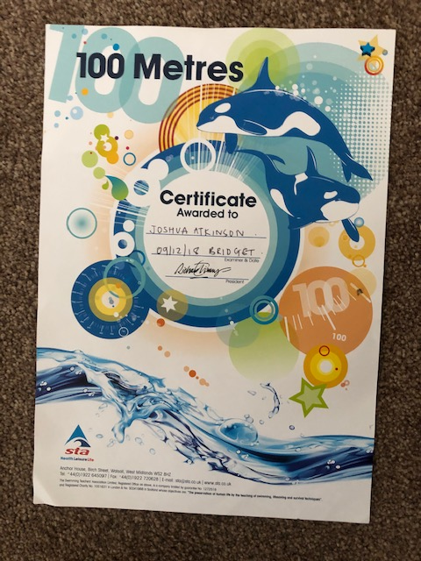
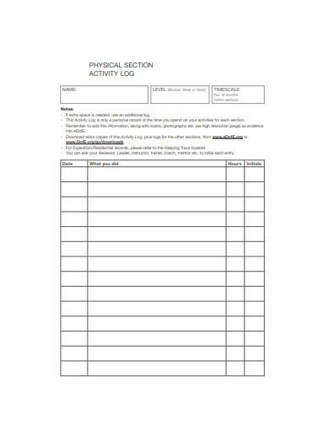
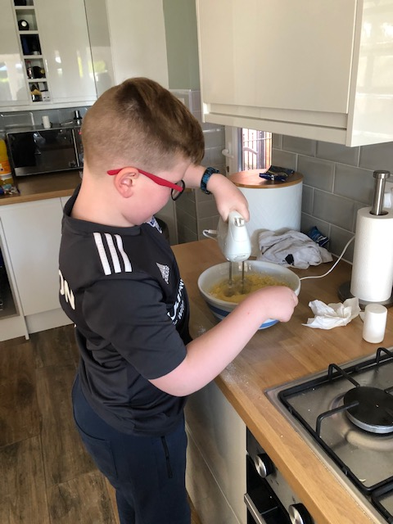
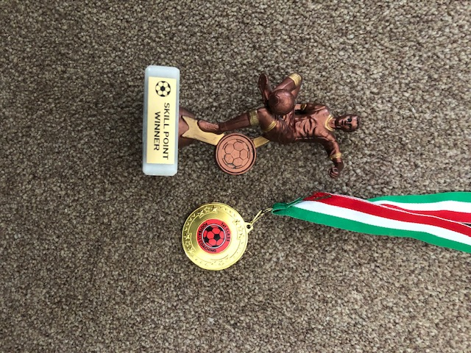
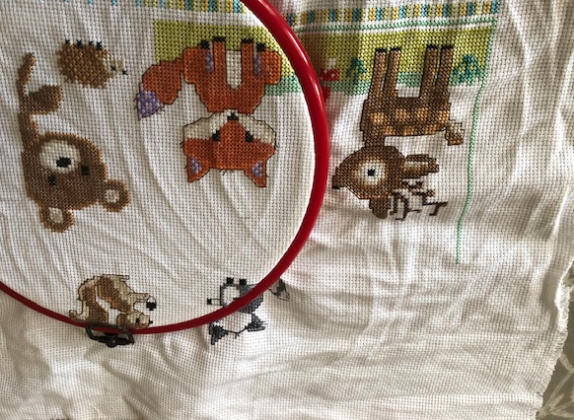
Supporting Evidence

Slide 14
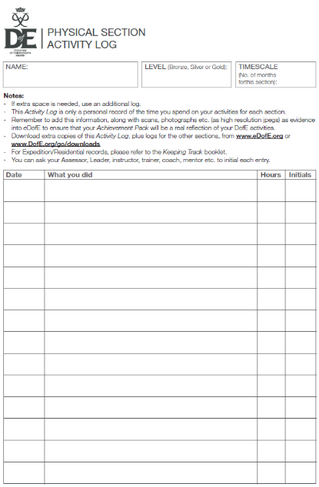
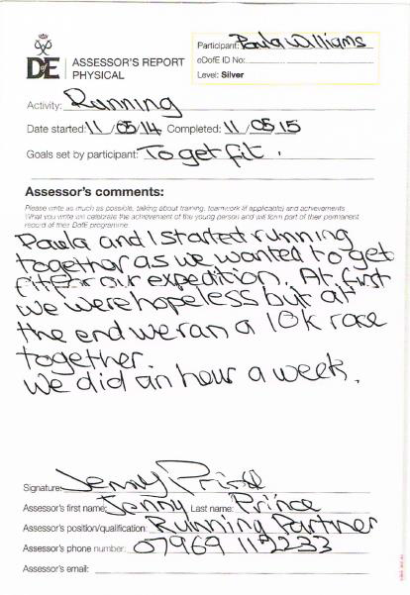
Assessor Reports and Evidence
All sections need an Adult Assessor Report. This cannot be done by a member of your family.
If you are doing an activity at home, you must identify an assessor, possibly someone in school. You can show them evidence and they can then write your assessor report.
A weekly activity log provides a good diary of your progress
Assessors’ reports must include:
  Assessor name, title/position and contact information
  Your name and details of your activity
  Your sectional activity dates
  A report on how well you did
Notes:
Discuss what is needed on Assessors reports and the additional option of Assessors submitting evidence through the portal for convenience: www.dofe.org/assessor

Slide 15
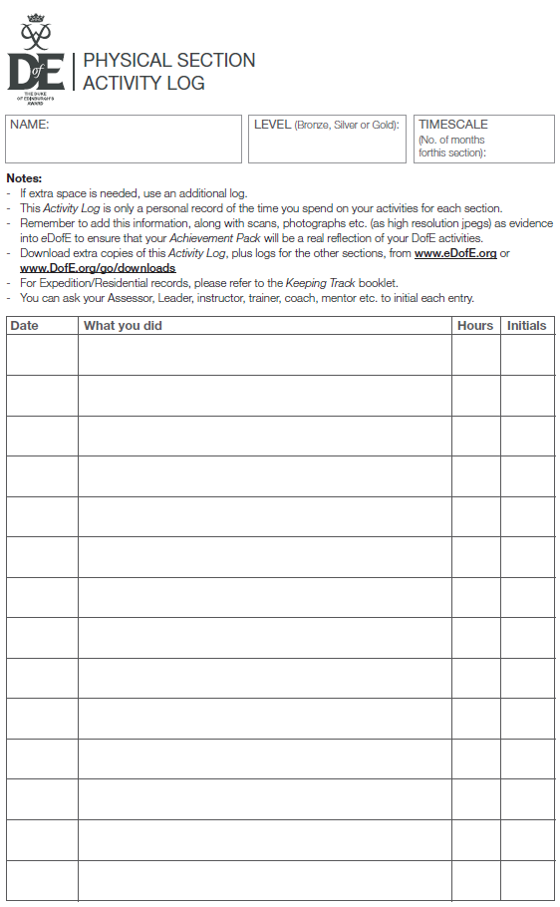
When you have finished…
When you’re done….
When you have completed all of your sections, add your Assessor’s reports and supporting evidence and submit the section for approval
Assessor reports must include all the mandatory information such as dates
Assessor reports can be done by using the paper template and uploaded by the participant as a photo or scan to eDofE
Assessor reports can be uploaded directly by the assessor online via dofe.org/assessor. The participant must give them their eDofE number *PUT THIS IN YOUR NOTES* and check that this has been uploaded. If not the participant must speak with the assessor
Notes:
Advise participants that Verifiers are the additional tier of approval beyond the Leader. Verifiers often pick up on additional queries, so remind them to log back in to respond to any queries…..the award isn’t completed until after the Verifier is happy!

Slide 16
eDofE Process
Participant submit programme planner for each section to DofE Leader/Manager before starting the activities.
Participant adds an assessor report for each section once completed the activities. This is then approved by a DofE Leader/Manager. They may query a section asking for more information
Once all four sections are complete the Award goes to be verified by the Award Verifier. They may query a section asking for more information
Once all approved a Certificate and badge is issued.
Remember to log back in to check Leader and Verifier comments!

Slide 17

Certificate of Achievement
We’ve launched a new accolade that recognises the fantastic accomplishments of these young people – the ‘2020 DofE Certificate of Achievement’.
The Certificate will be a formal recognition, by the DofE, of their dedication to their programmes and everything they’ve achieved through Volunteering, Physical and Skill sections, as well as their resilience in coping with the unprecedented events of this year. This is emailed to the participant once the three sections have been approved on eDofE.
This is in addition to the full Award, which is received once all four sections including the Expedition is completed.

Slide 18
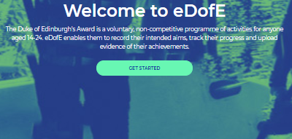
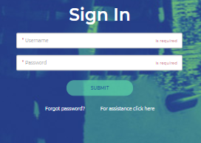
Logging into eDofE
Go to www.edofe.org
Click get started
Sign in with your username and temporary password (your date of birth with a four digit year)
If you can’t log in after the first time, let your DofE Leader know – after three times you will be logged out!

Slide 19

DofE Discount – Welcome Packs Home
Your welcome pack and discount card will be posted to your home address once entered in on eDofE. Your welcome pack contains information to give your assessor for each section and your assessor report cards.

Slide 20
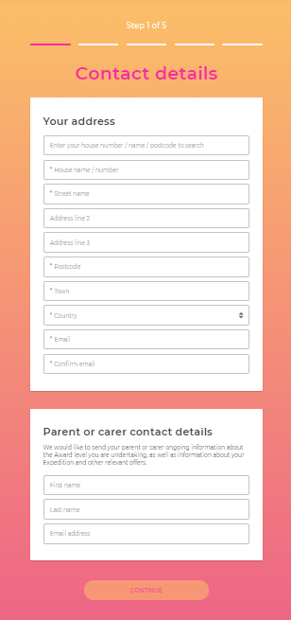
Contact Details Step 1
Start filling in your basic information, please complete all the boxes with a red star a as these are mandatory fields.
You will be asked to check/update your basic information yearly – it will still take you to the same account.
TIP – USE AN EMAIL ADDRESS IN REGULAR USE!

Slide 21
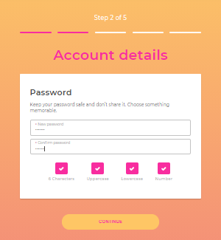
Account details – Step 2
Set a new password for your account
It must be at least 6 characters and include
one uppercase, one lowercase and one number
Please ensure it is something you will remember!

Slide 22
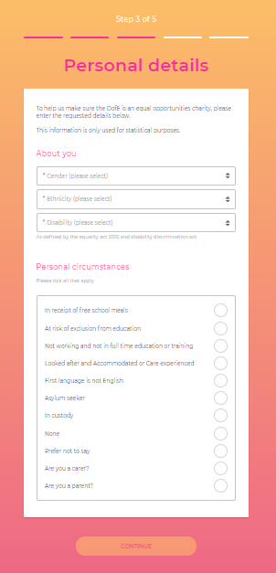
Personal Details Step 3
Step 3 - Personal details
Select/enter the mandatory personal details information
If you are completing the gold award in Northern Ireland, you will have the option to select which certificate type you want.

Slide 23
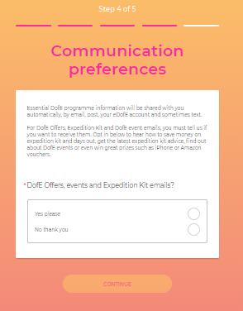
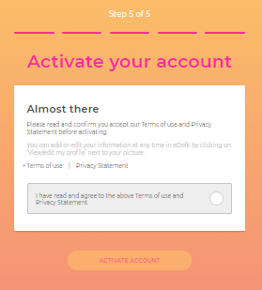
Step 4 and Step 5
Step 4 - Communication preferences
Select whether you would like to receive DofE offers, events and Expedition Kit emails
Step 5 - Activate your account
Read and confirm you accept the terms of use and privacy statement before activating your account
Once you’re ready, click the circle and select ‘Activate Account’

Slide 24
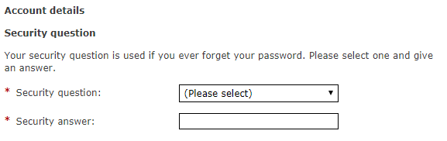
What to do if you forget your login
Q. What if I forget my login details ??
Tip: Your leader can change your password, and they can help with your username.
Tip: You can access your account through the normal web page and click [Forgot your password] and follow the prompt for your username and Security question

Slide 25

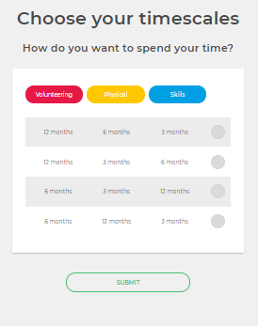
Start adding your timescales
If your account has been successfully set up, you should see the following screen, click continue.
Once you've completed your basic info and pressed 'Continue', you'll need to set your timescales before you can start adding your activity details.

Slide 26
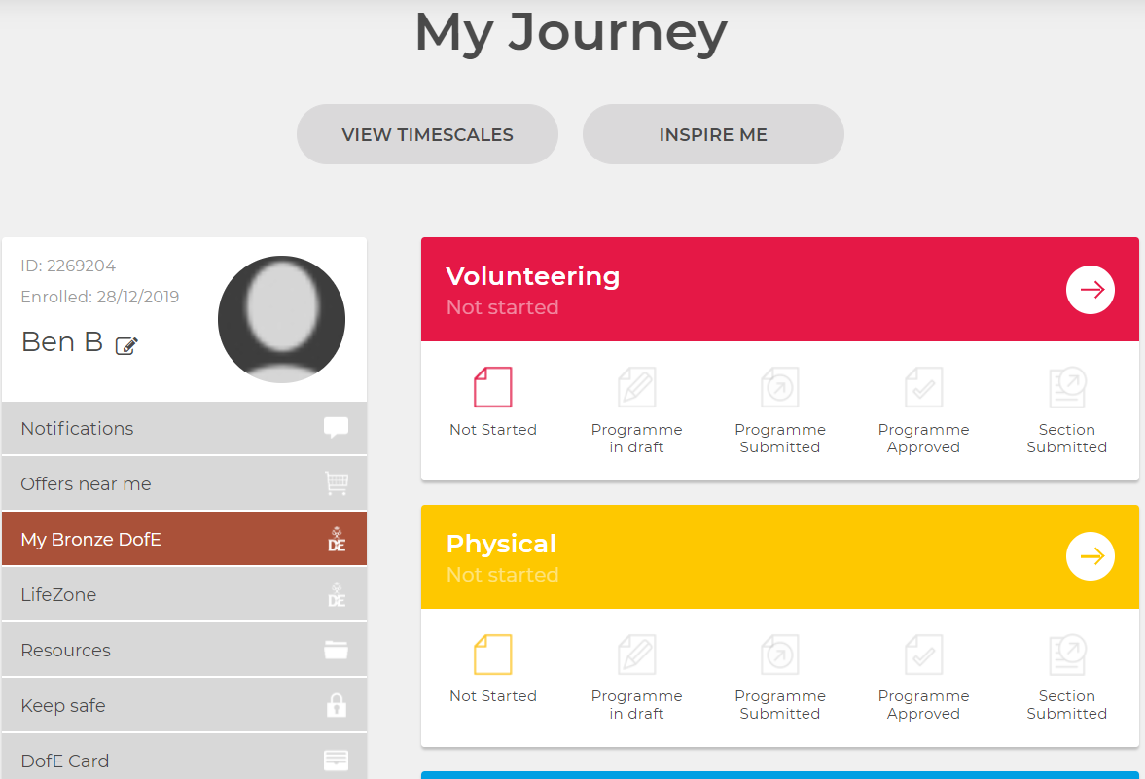
Add programme plans
Click the arrow on the section you want to add a program planner for – you can see the status of your section - the status icons are highlighted from left to right as the section status changes

Slide 27
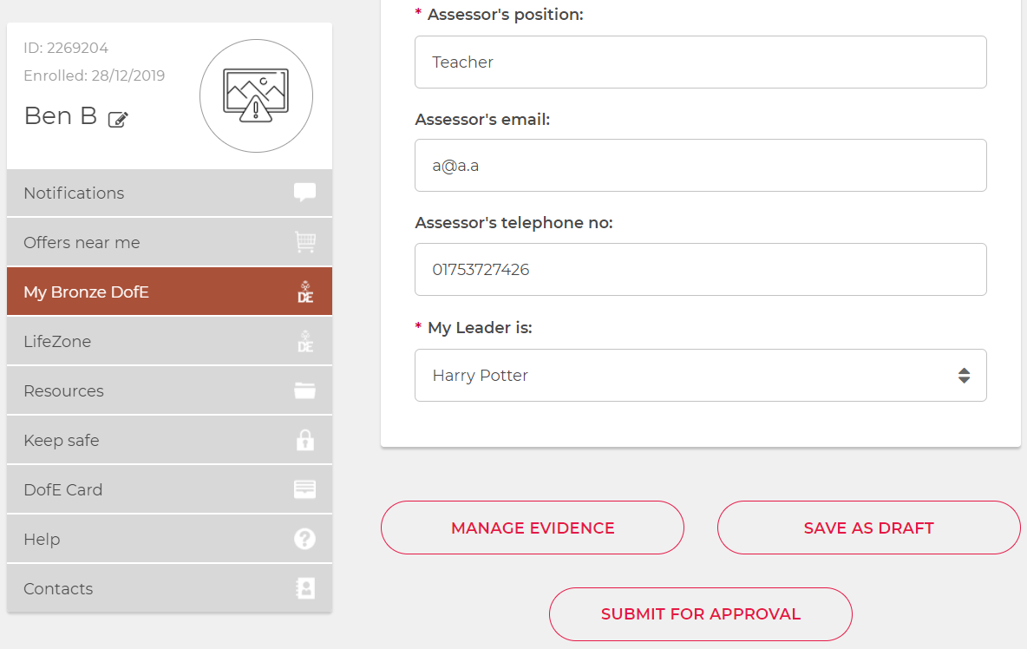
Add Programme Plans
Add all the mandatory information on the programme planner
.
Once you’ve completed it, click ‘Submit for approval’ and the programme planner will be sent to your DofE leader for approval – you should see a message notifying you and the section status icon 'Programme submitted' will be highlighted to show the current state of your section.

Slide 28

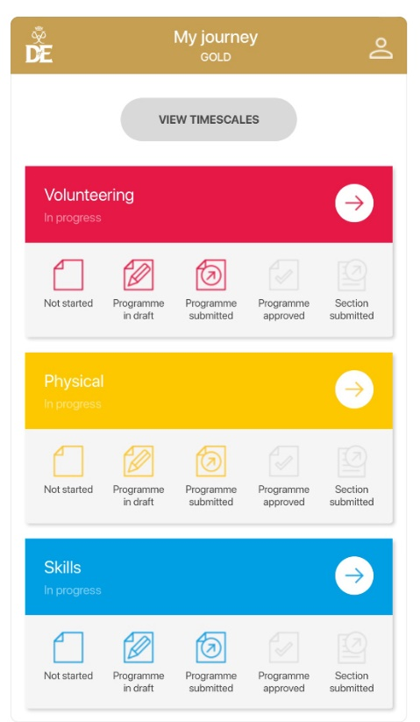
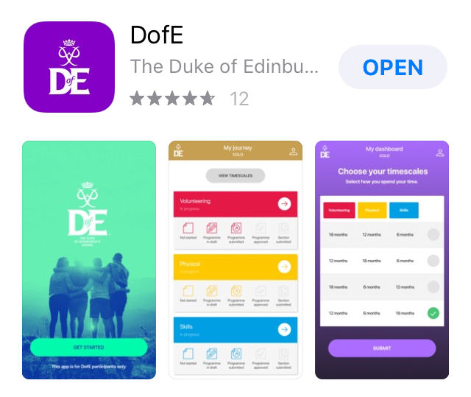
eDofE App
Mobile access
For easy eDofE access, you can download the ‘DofE’ App from an App Store for free. You can login for the first time and save your password. You can use the App for uploading assessor reports.
Notes:
Advise participants that Verifiers are the additional tier of approval beyond the Leader. Verifiers often pick up on additional queries, so remind them to log back in to respond to any queries…..the award isn’t completed until after the Verifier is happy!

Slide 29

NEXT STEPS
Log In
Complete Information for profile
Choose Timescales
Complete 2 Programme Planners – deadline 13th DECEMBER 2021
Get Evidence
After Completion – get assessors report
Have fun!

Slide 30
THE EXPEDITION
The expedition section of the award is your responsibility.
All students by the end of this academic year need to have completed a Bronze open expedition. They typically run between April and June. All students need to have booked this by latest February half term.
The open expeditions available can be found on the following link Opportunity Finder - Bronze Awards
Popular local AAP’s used in past are Mere Lane and First4Adventure. There are others available on the link. The Approved Activity Providers deliver both the training sessions and expeditions.
We encourage you to group with people you know and arrange to contact an expedition provider about completing the expedition. They may be able to provide dates for you to choose from.

